Slide 1


Breaking the Ice Online
with Jessica Mansbach

Slide 2
Plan for the Session
Intent of session
Convey the importance of icebreakers
Share examples of icebreakers
agenda
Icebreaker in break out rooms
Full group discussion
Sharing of examples

Slide 3

Instructions for Breaking the Ice Activity
Identify three interesting things you have in common. Be prepared to report back to the full group.

Slide 4

Reflection
  What do you have in common?
  What was that like?
  How might you adapt this activity for your course?

Slide 5
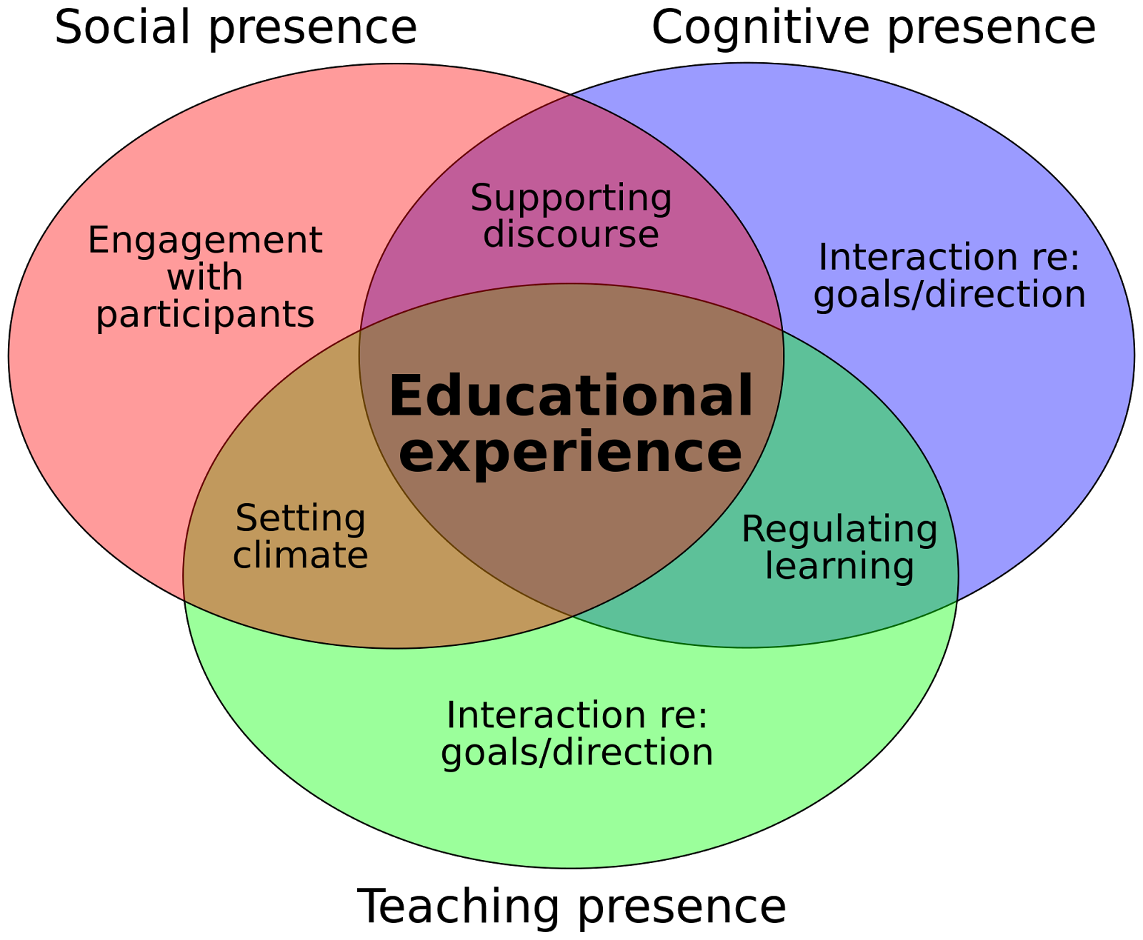
Breaking the ice to build community
Garrison, D. R., Anderson, T., & Archer, W. (2010). The first decade of the community of inquiry framework: A retrospective. The internet and higher education, 13(1-2), 5-9.

Slide 6

Types of Icebreakers
Team building
On the spot assessment
Immediate learning involvement

Slide 7
Team building icebreakers
help students get to know each other and allow them to experience working together to solve a problem or accomplish a task.

Slide 8
On the spot assessment icebreakers
in a low risk way, you can quickly gauge students’ understanding, knowledge, and level of exposure to a topic.

Slide 9
Immediate learning involvement icebreakers
  immediately involve students in the learning by generating interest in the topic and helping students consider how the topic is relevant to them.

Slide 10
What other icebreaker activities can you do?
Chat

Slide 11
Considerations for Doing Icebreakers
  How can all students participate?
  Will students be put on the spot?
  What purpose does the icebreaker serve?
  Are the instructions easy for all students to understand?

Slide 12
References
A Starter Activity to Begin Any Class
First Day of Class Activity: The Interest Inventory
Garrison, D. R., Anderson, T., & Archer, W. (2010). The first decade of the community of inquiry framework: A retrospective. The internet and higher education, 13(1-2), 5-9.
Icebreakers: Easing Group Contribution
Silberman, M. (1996). Active Learning: 101 Strategies To Teach Any Subject. Prentice-Hall.
The Importance of Icebreakers In Online Classes

